Slide 1
Analog Communications
Signals and Communication Systems (24EC2105)

Slide 2
Frequency Modulation based on
Modulation index

Slide 3
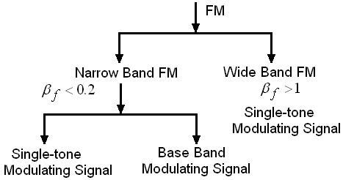

Slide 4
Narrowband F.M

Slide 5
Narrow Band Frequency Modulation (Single Tone)
The time domain expression for NBFM is
The frequency spectrum of Narrow Band Frequency Modulation is represented by

Slide 6
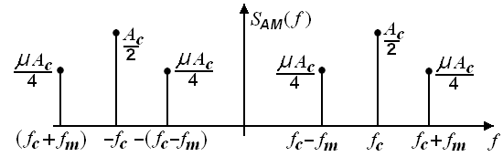
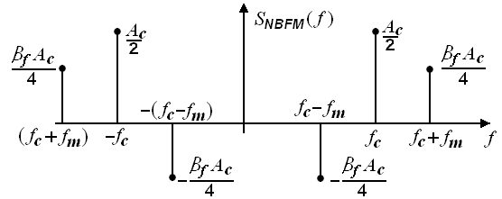
Spectrum of AM and NBFM
Spectrum of AM
Spectrum of NBFM

Slide 7
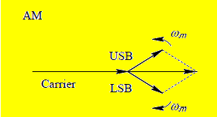
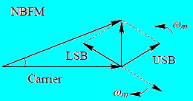
Phasor Diagrams

Slide 8
Bandwidth of NBFM
The time domain expression for NBFM is
It resembles the AM signal and hence bandwidth is twice of the message signal frequency

Slide 9
NBPM for Base Band Signal
For
,
and

Slide 10
Comparison
Similarities:
Both have the same modulated bandwidth 2W, where W is the highest modulating signal frequency.
The sideband spectrum for FM has a phase shift of 90⁰ with respect to the carrier, whereas that of AM is in-phase with the carrier.
Differences:
In an AM signal, the oscillation frequency is constant and the amplitude varies with time, whereas in an FM signal, the amplitude stays constant and frequency varies with time.

Slide 11
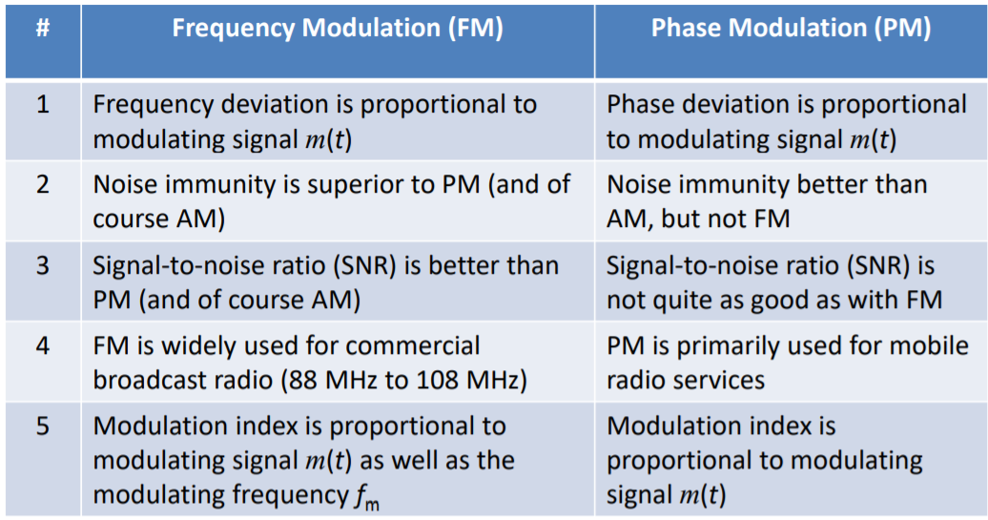

Slide 12
END

